Slide 1

Histogram
A histogram represents the frequencies of values of a variable bucketed into ranges. Histogram is similar to bar chat but the difference is it groups the values into continuous ranges
Syntax: - hist(v,main,xlab,xlim,ylim,breaks,col,border)
v is a vector containing numeric values
main indicates title of the chart
col is used to set color of the bars
border is used to set border color of each bar
xlab is used to give description of x-axis
xlim is used to specify the range of values on the x-axis
ylim is used to specify the range of values on the y-axis
breaks is used to mention the width of each bar.
1

Slide 2
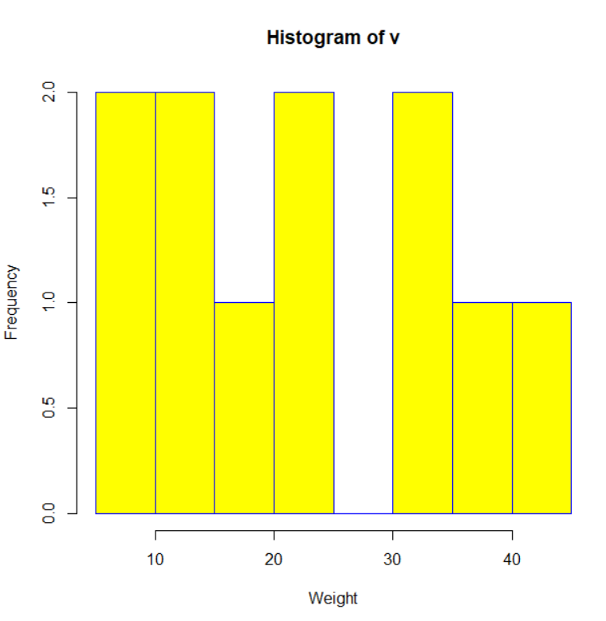
Histogram: Example
# Create data for the graph.
> v <- c(9,13,21,8,36,22,12,41,31,33,19)
# Create the histogram.
hist(v,xlab = "Weight",col = "yellow",border = "blue")

Slide 3
Your Turn
Plot histogram for GNI. Identify the range in which maximum countries are falling. Verify the class in which ‘India’ is falling. Are ‘India’ & ‘China’ falling in the same range?
Create a bar plot to represent number of countries in each region.
Plot a pie chart for Population of countries in ‘South-East Asia’ Region.
As in Q3, draw a 3D pie chart for ‘Eastern Mediterranean’ region.
Comparing the pie charts of Q3 and Q4, identify the region having higher variation in population.
Now, replace the labels with corresponding mean deviation in Q3 & Q4.
Verify your conclusion of Q5
Draw the scatterplot of ‘Under15’ & ‘Above60’. Give your interpretation in 1-2 lines.

Slide 4
Soln
hist(who$GNI)
x=as.data.frame(table(who$Region))
barplot(x$Freq, names.arg=x$Var1, xlab="Region", ylab="No of Countries")
who_sa=subset(who, who$Region=='South-East Asia’)
pie(who_sa$Population)
Same as in Q 3
???

